Slide 1
Minimum Spanning Tree

Slide 2
Graph: A graph is a collection of nodes (also called vertices) connected by edges. A graph can have cycles, directed or undirected edges, and may or may not be connected.
Tree: A tree is a specific type of graph with a hierarchical structure. It is an acyclic connected graph with exactly one path between any two nodes, and no cycles.

Slide 3
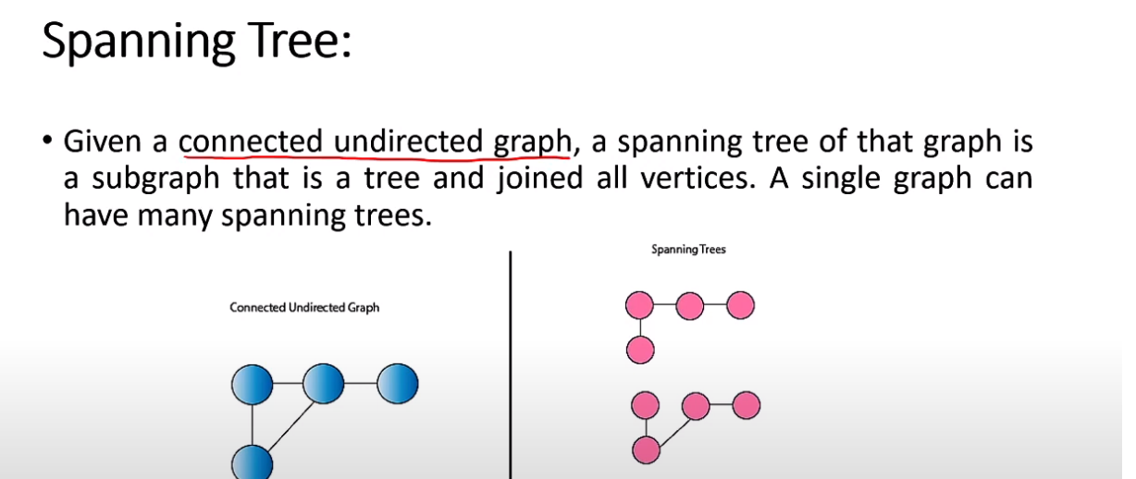
Spanning Tree

Slide 4
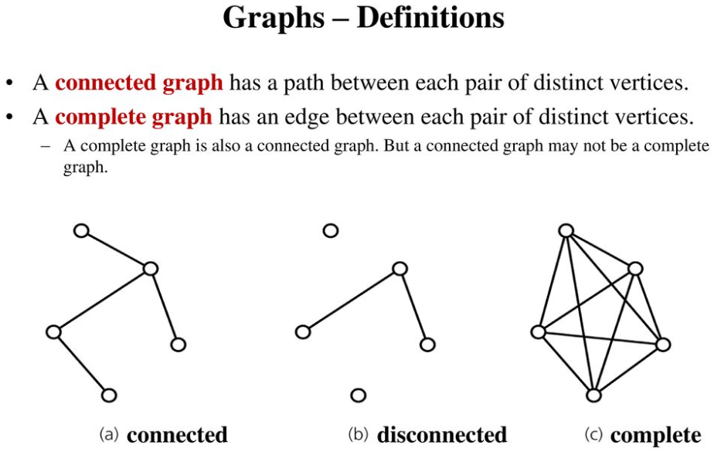

Slide 5
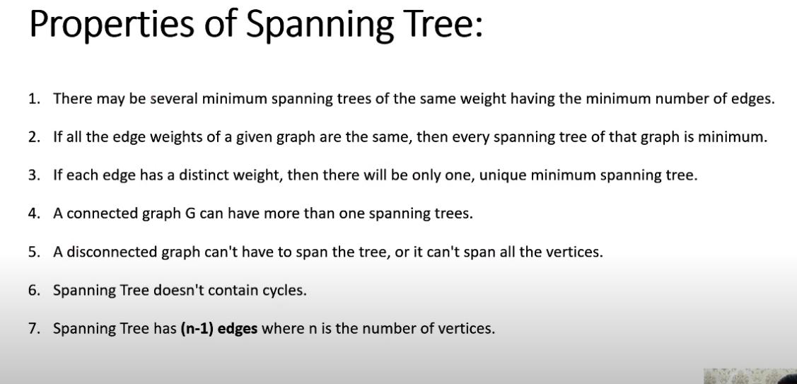

Slide 6
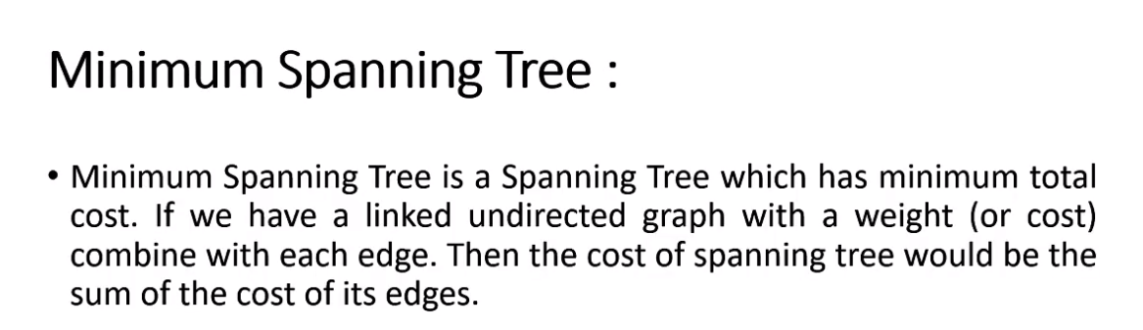
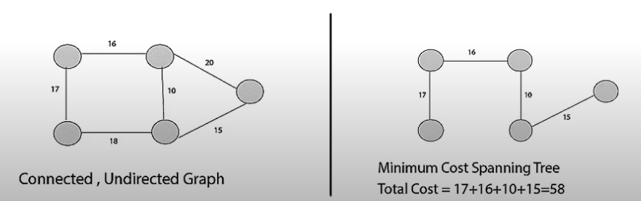

Slide 7
Minimum Spanning Tree (MST) Clustering is a graph-based approach to clustering that utilizes the Minimum Spanning Tree of a set of data points. It is particularly useful when you want to partition data into clusters without assuming specific shapes (like spherical clusters in K-means) or requiring parametric models.

Slide 8
Concepts
Minimum Spanning Tree (MST):
An MST is a subgraph of a graph that connects all vertices with the minimum total edge weight and contains no cycles.
Distance Graph:
For a dataset with nnn points, a distance graph is constructed where each data point represents a vertex, and the edges are weighted by the distances (e.g., Euclidean distance) between points.
Clustering Using MST:
  Build the MST from the graph. Algorithms like Kruskal’s or Prim’s are commonly used.
  Remove edges with the largest weights in the MST. The rationale is that large edge weights likely indicate a separation between clusters.
  The resulting connected components of the graph after edge removal correspond to clusters.

Slide 9
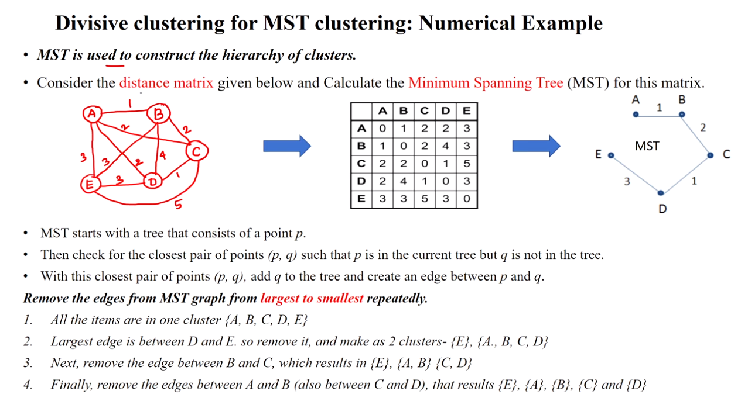

Slide 10
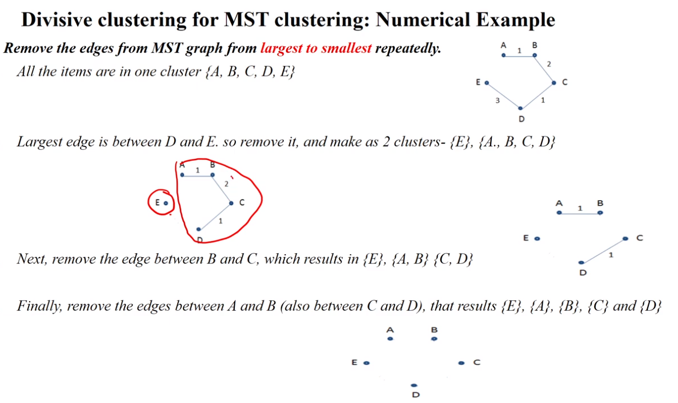

Slide 11
Reference
88 Minimum Spanning Tree Hierarchical (Top-Down) Clustering - YouTube

